Slide 1
INTUBATION AND INTUBATION DRUGS
Prepared by Ligi Sara Zacharia

Slide 2
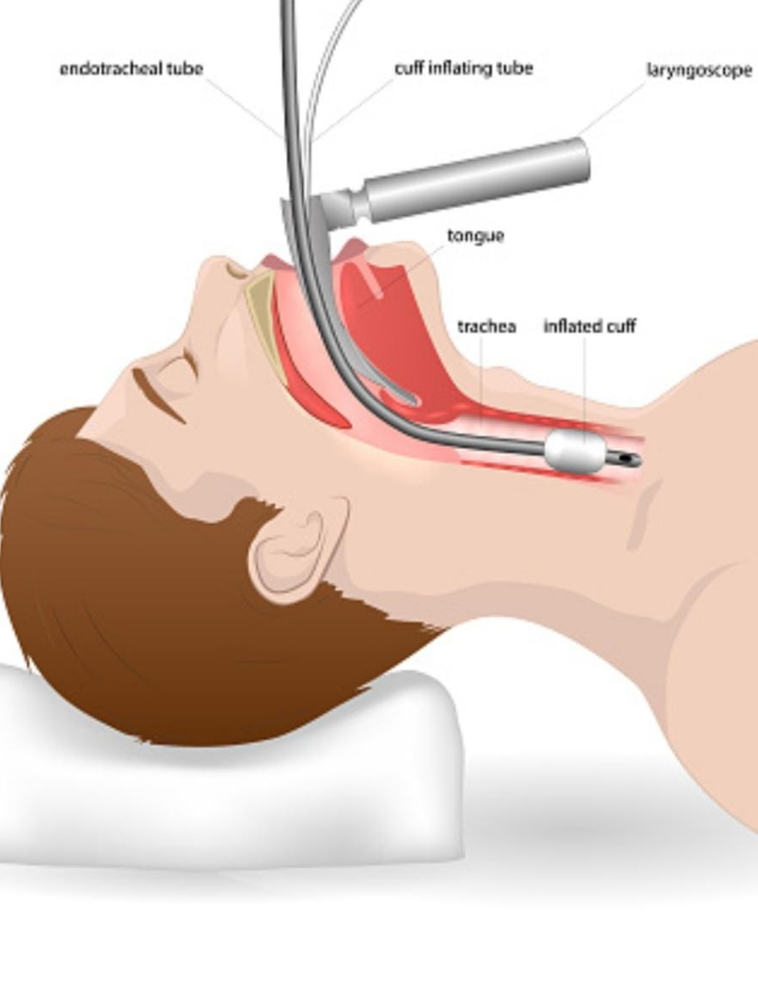
Definition
Endotracheal Intubation is a common procedure used during resuscitation and stabilization of critically ill children. The most common reason is respiratory distress.

Slide 3
Indications
Oxygenation and ventilation abnormalities
Cyanosis with FiO2>0.6
PAO2 < 52mmHg with FiO2 > 0.6
Failure to non invasively oxygenate
Excessive work of breathing
Apnea
GCS<8 to protect the airway
Rising Paco2 and acidosis
Neuromuscular diseases
Respiratory Muscle dysfunction with respiratory muscle fatigue and chest wall abnormalities
Post Arrest

Slide 4
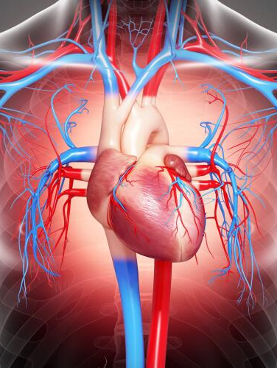
Adverse Events
Esophageal Intubation
Severe Desaturation
Hypotension
Laryngospasm
Air Leak
Cardiac Arrest
Mortality

Slide 5
Risk Factors
Respiratory Disease
Severity of illness and hemodynamic instability
History of difficult airway
Experience of the Intubator.
Lack of safety equipment (Capnography and alternative airway)
Lack of planning of the process

Slide 6
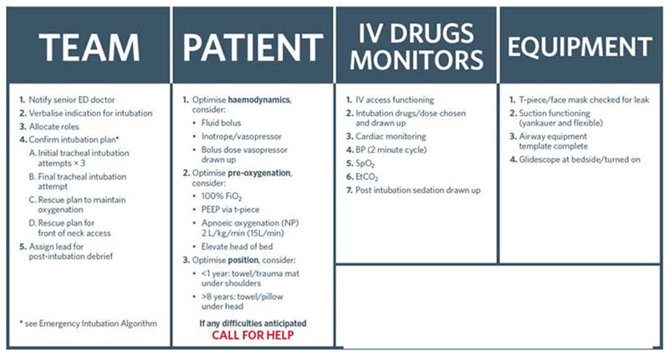
EMERGENCY TRACHEAL INTUBATION CHECKLIST
For team leader use prior to every Emergency Intubation

Slide 7
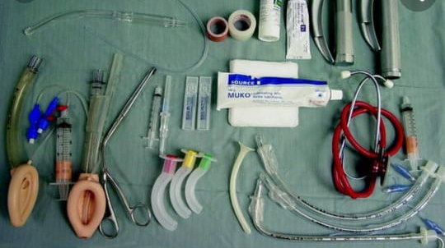

Slide 8
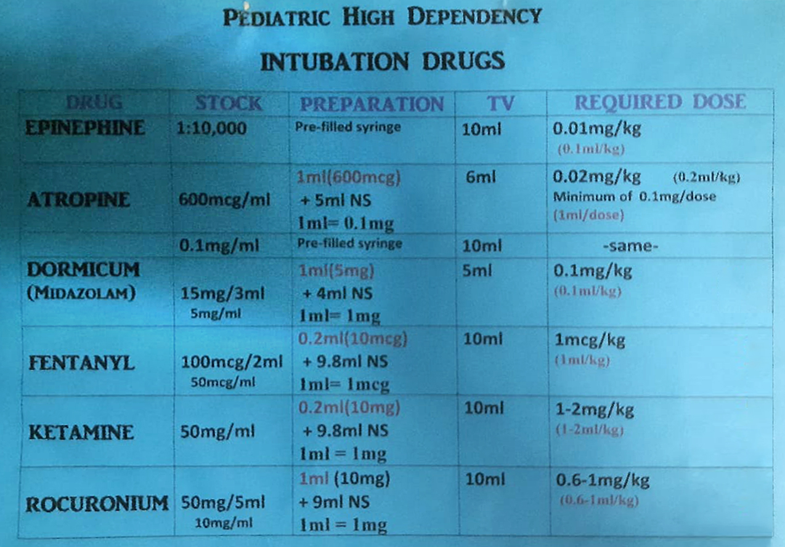

Slide 9


